Slide 1
GROUP DISCUSSION

Slide 2
Group Discussion is a modern method of assessing students personality.
It is both a technique and an art and a comprehensive tool to judge the worthiness of the student and his appropriateness for the job.

Slide 3
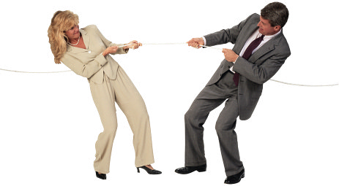
GD is not an Argument

Slide 4
Difference between Discussion, Debate and GD
Debate – Either Winning or Losing.
Discussion – Expression of your point of view and respecting another's point of view.
A GD, however, calls for a lot more maturity and logic as it is sharing of our own ideas and thoughts with the group.

Slide 5
Why do GD’s happen?
To prepare you for the future and make you well informed.
To make you listen and talk in a mature and logical manner.
If you need to disagree, then doing so in a graceful manner.
Attacking issues not people.
Carefully listen to other people's points and try to refine your own by using other people's inputs on the subject.

Slide 6
TYPES OF GD:
GD can be Topic based or Case based-
Topic based group discussion can be of three types:
Factual topics
Controversial topics
Abstract topics

Slide 7
FACTUAL TOPICS
Factual topics are about practical things, which an ordinary person is aware of in his day to day life
Typically they are socio- economic topics. These can be the current topic.
Such topics gives a candidate a chance to prove that he is aware of and sensitive to his environment.

Slide 8
CONTROVERSIAL TOPICS
They are the ones that are argumentative in nature. They are meant to generate controversy.
In GDs where such topics are given for discussion the noise and temper is usually high.
The idea behind giving such topic is likely to see how much maturity the candidate is displaying by keeping his temper in check.

Slide 9
ABSTRACT TOPICS
Abstract topics are about intangible things.
These topics are used to check your lateral thinking and creativity.
Eg: the number 10
Joy
Color red

Slide 10
CASE BASED GD
Another variation is the use of case instead of a topic.
The case study tries to simulate a real life situation . Information about the situation will be given to you and you would be asked as a group to resolve the situation.
In case study there are no incorrect answers or perfect solutions.
The objective is to get you think about the situation from various angles.

Slide 11
What does GD check ?
Communication Skills
Knowledge
Reasoning ability
Leadership Skills
Flexibility
Convincing power
Ability to work in team
Creativity
Group Dynamics
Level of maturity
Interpersonal skills
Initiative attitude

Slide 12
Preparation for GD?
GD reflects the inherent qualities of an individual .
Reading: This is the first and the most crucial step in preparation.
Mocks: Create an informal GD group and meet regularly to discuss and exchange feedback.

Slide 13
Personalities Reflected in a GD
Passive
Submissive
Hesitates to Take Initiative
Assertive
Open to Accept Ideas
Initiates and Encourages others
Aggressive
Dominating
Argumentative

Slide 16
Parameters of Evaluation in GD

Slide 18
TIPS FOR PARTICIPATION in GD…
Taking a Position viz-a-viz the Topic…
Always take a holistic view of the topic
Avoid statements like:
- “I whole heartedly support the topic”
- “I completely disagree with the topic”
Start as, “there are points in favor of and against the topic…..”

Slide 19
If You have Soft Voice…
Raise voice level but do not shout
Look for moments when the noise levels are not very high and get into the discussion.
If You are Interrupted while Discussing your Topic…
Tell in clear and unambiguous terms that you should be allowed to speak
You can say:
Excuse me, please let me complete
Just a minute-let me finish my point
Raise your voice slightly

Slide 20
How to Get into the Discussion…
Take Initiative
Be attentive and get into discussion comfortably
Identify strong speakers and soft speakers in group
Get into Discussion…
By using sentences like
“Yes, what you say is true…..”
“….but there is something more that we should look at…”
“…and there is another reason to support what you say…”

Slide 21
Summarization Techniques
Most GD’s do not really have conclusions.
Keep the following points in mind while summarizing a discussion:
Avoid raising new points.
Avoid stating only your viewpoint.
Avoid dwelling only on one aspect of the GD.
Keep it brief and concise.
It must incorporate all the important points that came out during the GD.
If the examiner asks you to summarize a GD, it means the GD has come to an end. Do not add anything once the GD has been summarized.

Slide 22
The Perfect Candidate
Be attentive
Personal appearance
Answering questions completely
Wide knowledge
Positive attitude and behavior
Good communication skills

Slide 24
Making a good “First Impression”
The way you dress is the single biggest nonverbal communication you make about yourself.
Your dress conveys success, trustworthiness, intelligence and suitability.
Lean towards the conservative side of style.
Avoid loud colors and printed fabrics
Make sure your clothes are nicely pressed.
Bring an extra tie, shirt or scarf

Slide 25
Body
Remember the DIGIT
4

Slide 29
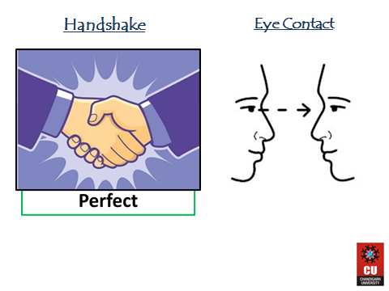

Slide 34
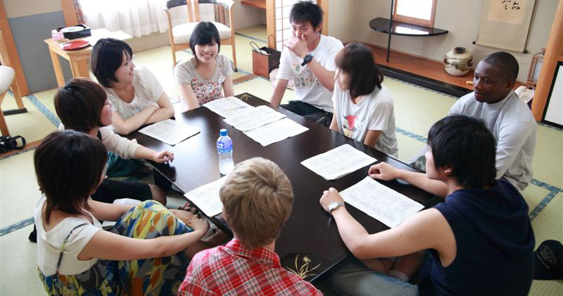

Slide 36
Be Like this…………

Slide 37
Few GD Topics:
E- books or printed books: what's your choice?
Government schools Vs private schools
Demonitization– success or publicity
Hard work or smart work – Which is better
Should politicians have retirement age.
Should capital punishment be legal? Yes or no

